Slide 1
Data Mining:
Concepts and Techniques —
Unit II: Data Warehouse and
OLAP Technology for Data Mining
Data Mining: Concepts and Techniques

Slide 2
Data Warehousing and OLAP Technology: An Overview
What is a data warehouse?
A multi-dimensional data model
Data warehouse architecture
Data warehouse implementation
From data warehousing to data mining
Further Development of Data Cube Technology
Data Mining: Concepts and Techniques

Slide 3


What Is Data Mining?
Data mining (knowledge discovery from data)
  Extraction of interesting (non-trivial, implicit, previously unknown and potentially useful) patterns or knowledge from huge amount of data
  Data mining: a misnomer?
Alternative names
  Knowledge discovery (mining) in databases (KDD), knowledge extraction, data/pattern analysis, data archeology, data dredging, information harvesting, business intelligence, etc.
Watch out: Is everything “data mining”?
  Simple search and query processing
  (Deductive) expert systems
Data Mining: Concepts and Techniques

Slide 4
KDD Process
Knowledge
  Data mining—core of knowledge discovery process
Pattern Evaluation
Data Mining
Task-relevant Data
Data Warehouse
Selection
Data Cleaning
Data Integration
Databases
Data Mining: Concepts and Techniques

Slide 5
Data Mining and Business Intelligence
Increasing potential
to support
business decisions
End User
Decision Making
Data Presentation
Business
Analyst
Visualization Techniques
Data Mining
Data
Analyst
Information Discovery
Data Exploration
Statistical Summary, Querying, and Reporting
Data Preprocessing/Integration, Data Warehouses
Data Sources
DBA
Paper, Files, Web documents, Scientific experiments, Database Systems
Data Mining: Concepts and Techniques

Slide 6
What is Data Warehouse?
Defined in many different ways, but not rigorously.
  A decision support database that is maintained separately from the organization’s operational database
  Support information processing by providing a solid platform of consolidated, historical data for analysis.
“A data warehouse is a subject-oriented, integrated, time-variant, and nonvolatile collection of data in support of management’s decision-making process.”—W. H. Inmon
Data warehousing:
  The process of constructing and using data warehouses
Data Mining: Concepts and Techniques

Slide 7
Data Warehouse—Subject-Oriented
Organized around major subjects, such as customer, product, sales
Focusing on the modeling and analysis of data for decision makers, not on daily operations or transaction processing
Provide a simple and concise view around particular subject issues by excluding data that are not useful in the decision support process
Data Mining: Concepts and Techniques

Slide 8

A Sample Data Warehouse (Data Cube) for SALES
Date
Total annual sales
of TV in U.S.A.
1Qtr
2Qtr
3Qtr
4Qtr
sum
Product
TV
PC
U.S.A
VCR
sum
Canada
Country
Mexico
sum
All, All, All
Data Mining: Concepts and Techniques

Slide 9
Data Warehouse—Integrated
Constructed by integrating multiple, heterogeneous data sources
  relational databases, flat files, on-line transaction records
How?
Data cleaning and integration techniques are applied.
  Ensure consistency in naming conventions, encoding structures, attribute measures, etc. among different data sources
    E.g., Hotel price: currency, tax, breakfast covered, etc.
  When data is moved to the warehouse, it is converted.
Data Mining: Concepts and Techniques

Slide 10
Data Warehouse—Time Variant
The time horizon for the data warehouse is significantly longer than that of operational systems
  Operational database: current value data
  Data warehouse data: provide information from a historical perspective (e.g., past 5-10 years)
Every key structure in the data warehouse
  Contains an element of time, explicitly or implicitly
  But the key of operational data may or may not contain “time element”
Data Mining: Concepts and Techniques

Slide 11
Data Warehouse—Nonvolatile
A physically separate store of data transformed from the operational environment
Operational update of data does not occur in the data warehouse environment
  Does not require transaction processing, recovery, and concurrency control mechanisms
  Requires only two operations in data accessing:
    initial loading of data and access of data
Data Mining: Concepts and Techniques

Slide 12
Data Warehouse vs. Operational DBMS
OLTP (on-line transaction processing)
  Major task of traditional relational DBMS
  Day-to-day operations: purchasing, inventory, banking, manufacturing, payroll, registration, accounting, etc.
OLAP (on-line analytical processing)
  Major task of data warehouse system
  Data analysis and decision making
Data Mining: Concepts and Techniques

Slide 13
5 Distinct features (OLTP vs. OLAP):
Data contents: current, detailed vs. historical, consolidated
Database design: ER + application vs. star + subject
View: current, local vs. evolutionary, integrated
Access patterns: update vs. read-only but complex queries
User and system orientation: customer vs. market
Data Mining: Concepts and Techniques

Slide 14
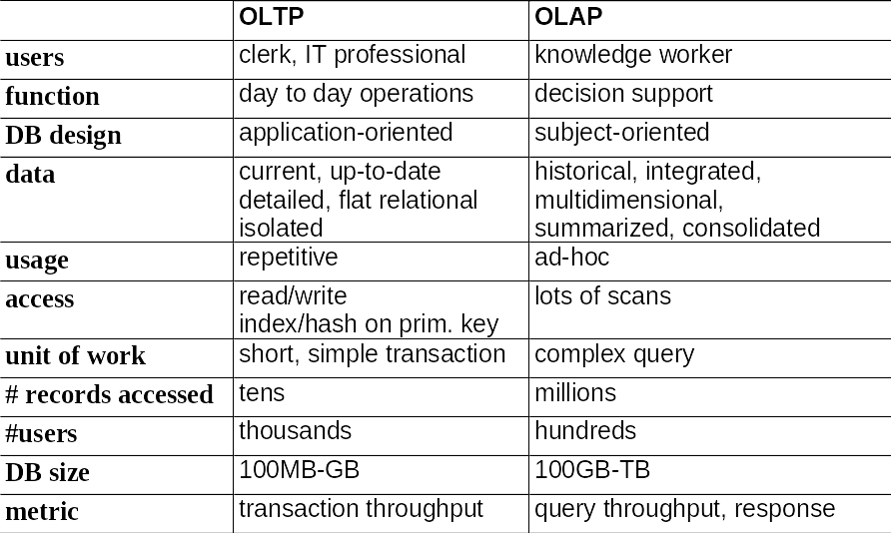
OLTP vs. OLAP
Data Mining: Concepts and Techniques

Slide 15
Why Separate Data Warehouse?
High performance for both systems
  DBMS—
    tuned for OLTP: access methods, indexing, concurrency control, recovery
  Warehouse—
    tuned for OLAP: complex OLAP queries, multidimensional view, consolidation
Data Mining: Concepts and Techniques

Slide 16
Why Separate Data Warehouse? (contd.)
Different functions and different data:
  Missing data: Decision support requires historical data which operational DBs do not typically maintain
  Data Consolidation: DS requires consolidation (aggregation, summarization) of data from heterogeneous sources
  Data Quality: different sources typically use inconsistent data representations, codes and formats which have to be reconciled
Note: There are more and more systems which perform OLAP analysis directly on relational databases
Data Mining: Concepts and Techniques

Slide 17
Data Warehousing and OLAP Technology: An Overview
What is a data warehouse?
A multi-dimensional data model
Data warehouse architecture
Data warehouse implementation
From data warehousing to data mining
Data Mining: Concepts and Techniques

Slide 18
From Tables and Spreadsheets to Data Cubes
A data warehouse is based on a multidimensional data model which views data in the form of a data cube
A data cube, such as sales, allows data to be modeled and viewed in multiple dimensions
  Dimension tables, such as item (item_name, brand, type), or time(day, week, month, quarter, year)
  Fact table contains measures (such as dollars_sold) and keys to each of the related dimension tables
Data Mining: Concepts and Techniques

Slide 19
Data Cube- Cuboid Types
In data warehousing literature, an n-D base cube is called a base cuboid. The top most 0-D cuboid, which holds the highest-level of summarization, is called the apex cuboid. The lattice of cuboids forms a data cube.
Data Mining: Concepts and Techniques

Slide 20
A Sample Data Cube
Date
Total annual sales
of TV in U.S.A.
1Qtr
2Qtr
3Qtr
4Qtr
sum
Product
TV
PC
U.S.A
VCR
sum
Canada
Country
Mexico
sum
All, All, All
Data Mining: Concepts and Techniques

Slide 21
Cube: A Lattice of Cuboids
all
0-D(apex) cuboid
time
item
location
supplier
1-D cuboids
time,location
item,location
location,supplier
2-D cuboids
time,item
time,supplier
item,supplier
time,location,supplier
3-D cuboids
time,item,location
time,item,supplier
item,location,supplier
4-D(base) cuboid
time, item, location, supplier
Data Mining: Concepts and Techniques

Slide 22
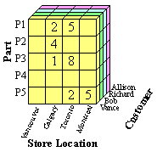
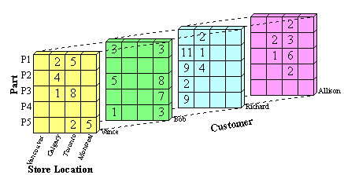
Stored Data Cubes
Data Mining: Concepts and Techniques

Slide 23
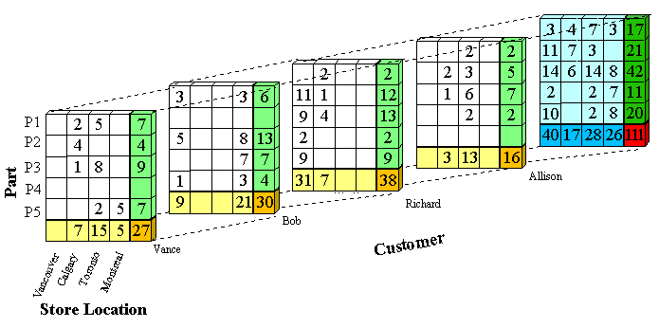
Computed Data Cubes
Data Mining: Concepts and Techniques

Slide 24
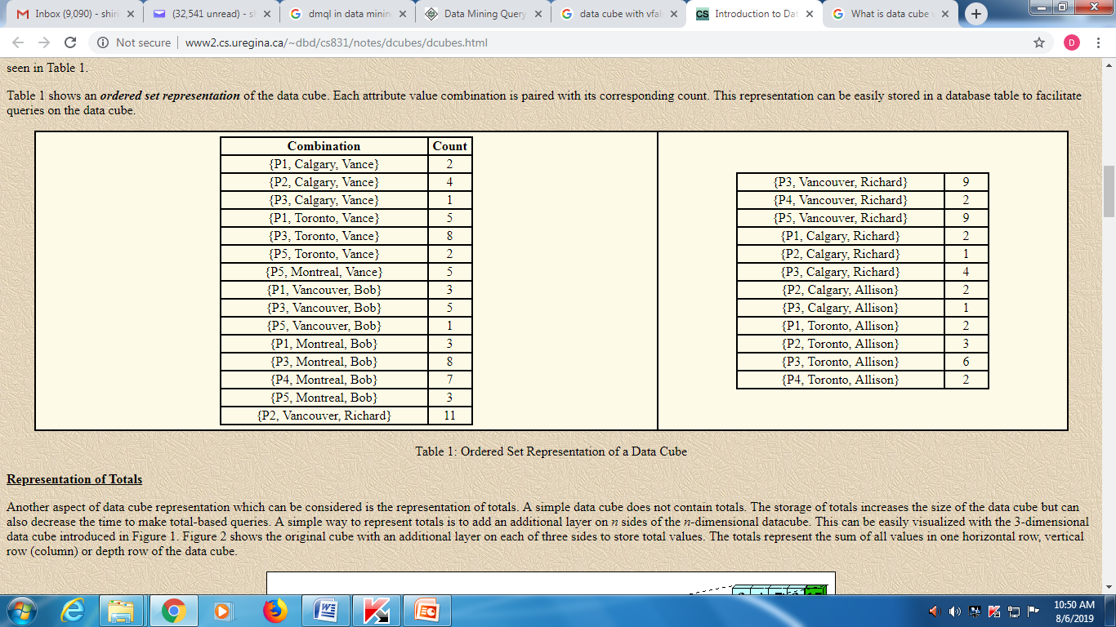
Ordered Set representation of a Data Cube
Data Mining: Concepts and Techniques

Slide 25
Conceptual Modeling of Data Warehouses
Modeling data warehouses: dimensions & measures
  Star schema: A fact table in the middle connected to a set of dimension tables
  Snowflake schema: A refinement of star schema where some dimensional hierarchy is normalized into a set of smaller dimension tables, forming a shape similar to snowflake
  Fact constellations: Multiple fact tables share dimension tables, viewed as a collection of stars, therefore called galaxy schema or fact constellation
Data Mining: Concepts and Techniques

Slide 26
Example of Star Schema
time
time_key
day
day_of_the_week
month
quarter
year
item
item_key
item_name
brand
type
supplier_type
Sales Fact Table
time_key
item_key
branch_key
branch
location
location_key
branch_key
branch_name
branch_type
location_key
street
city
state_or_province
country
units_sold
dollars_sold
avg_sales
Measures
Data Mining: Concepts and Techniques

Slide 27
Example of Snowflake Schema
time
item
time_key
day
day_of_the_week
month
quarter
year
item_key
item_name
brand
type
supplier_key
supplier
Sales Fact Table
supplier_key
supplier_type
time_key
item_key
branch_key
branch
location
location_key
location_key
street
city_key
branch_key
branch_name
branch_type
units_sold
dollars_sold
city
city_key
city
state_or_province
country
avg_sales
Measures
Data Mining: Concepts and Techniques

Slide 28
Example of Fact Constellation
time
time_key
day
day_of_the_week
month
quarter
year
item
Shipping Fact Table
item_key
item_name
brand
type
supplier_type
Sales Fact Table
time_key
time_key
item_key
shipper_key
item_key
branch_key
from_location
branch
location_key
location
to_location
branch_key
branch_name
branch_type
units_sold
location_key
street
city
province_or_state
country
dollars_cost
dollars_sold
units_shipped
avg_sales
shipper
Measures
shipper_key
shipper_name
location_key
shipper_type
Data Mining: Concepts and Techniques

Slide 29
Cube Definition Syntax (BNF) in DMQL
Cube Definition (Fact Table)
  define cube <cube_name> [<dimension_list>]: <measure_list>
Dimension Definition (Dimension Table)
  define dimension <dimension_name> as (<attribute_or_subdimension_list>)
Special Case (Shared Dimension Tables)
  First time as “cube definition”
  define dimension <dimension_name> as <dimension_name_first_time> in cube <cube_name_first_time>
Data Mining: Concepts and Techniques

Slide 30
Defining Star Schema in DMQL
define cube sales_star [time, item, branch, location]:
    dollars_sold = sum(sales_in_dollars), avg_sales = avg(sales_in_dollars), units_sold = count(*)
define dimension time as (time_key, day, day_of_week, month, quarter, year)
define dimension item as (item_key, item_name, brand, type, supplier_type)
define dimension branch as (branch_key, branch_name, branch_type)
define dimension location as (location_key, street, city, province_or_state, country)
Data Mining: Concepts and Techniques

Slide 31
Defining Snowflake Schema in DMQL
define cube sales_snowflake [time, item, branch, location]:
    dollars_sold = sum(sales_in_dollars), avg_sales = avg(sales_in_dollars), units_sold = count(*)
define dimension time as (time_key, day, day_of_week, month, quarter, year)
define dimension item as (item_key, item_name, brand, type, supplier(supplier_key, supplier_type))
define dimension branch as (branch_key, branch_name, branch_type)
define dimension location as (location_key, street, city(city_key, province_or_state, country))
Data Mining: Concepts and Techniques

Slide 32
Defining Fact Constellation in DMQL
define cube sales [time, item, branch, location]:
    dollars_sold = sum(sales_in_dollars), avg_sales = avg(sales_in_dollars), units_sold = count(*)
define dimension time as (time_key, day, day_of_week, month, quarter, year)
define dimension item as (item_key, item_name, brand, type, supplier_type)
define dimension branch as (branch_key, branch_name, branch_type)
define dimension location as (location_key, street, city, province_or_state, country)
define cube shipping [time, item, shipper, from_location, to_location]:
    dollar_cost = sum(cost_in_dollars), unit_shipped = count(*)
define dimension time as time in cube sales
define dimension item as item in cube sales
define dimension shipper as (shipper_key, shipper_name, location as location in cube sales, shipper_type)
define dimension from_location as location in cube sales
define dimension to_location as location in cube sales
Data Mining: Concepts and Techniques

Slide 33
Measures of Data Cube: Three Categories
Distributive: if the result derived by applying the function to n aggregate values is the same as that derived by applying the function on all the data without partitioning
    E.g., count(), sum(), min(), max()
Algebraic: if it can be computed by an algebraic function with M arguments (where M is a bounded integer), each of which is obtained by applying a distributive aggregate function
    E.g., avg(), min_N(), standard_deviation()
Holistic: if there is no constant bound on the storage size needed to describe a subaggregate.
    E.g., median(), mode(), rank()
Data Mining: Concepts and Techniques

Slide 34
A Concept Hierarchy: Dimension (location)
all
all
region
Europe
...
North_America
country
Germany
...
Spain
Canada
...
Mexico
city
Frankfurt
...
Vancouver
...
Toronto
office
L. Chan
...
M. Wind
Data Mining: Concepts and Techniques

Slide 35
View of Warehouses and Hierarchies
Specification of hierarchies
Schema hierarchy
  day < {month < quarter; week} < year
Set_grouping hierarchy
  {1..10} < inexpensive
Data Mining: Concepts and Techniques

Slide 36
Multidimensional Data
Sales volume as a function of product, month, and region
Dimensions: Product, Location, Time
Hierarchical summarization paths
Region
Industry Region Year
Category Country Quarter
Product City Month Week
Office Day
Product
Month
Data Mining: Concepts and Techniques

Slide 37
A Sample Data Cube
Date
Total annual sales
of TV in U.S.A.
1Qtr
2Qtr
3Qtr
4Qtr
sum
Product
TV
PC
U.S.A
VCR
sum
Canada
Country
Mexico
sum
All, All, All
Data Mining: Concepts and Techniques

Slide 38
Typical OLAP Operations
Roll up (drill-up): summarize data
  by climbing up hierarchy or by dimension reduction
Drill down (roll down): reverse of roll-up
  from higher level summary to lower level summary or detailed data, or introducing new dimensions
Slice and dice: project and select
Pivot (rotate): reorient the cube, visualization, 3D to series of 2D planes
Other operations
  drill across: involving (across) more than one fact table
  drill through: through the bottom level of the cube to its back-end relational tables (using SQL)
Data Mining: Concepts and Techniques

Slide 39
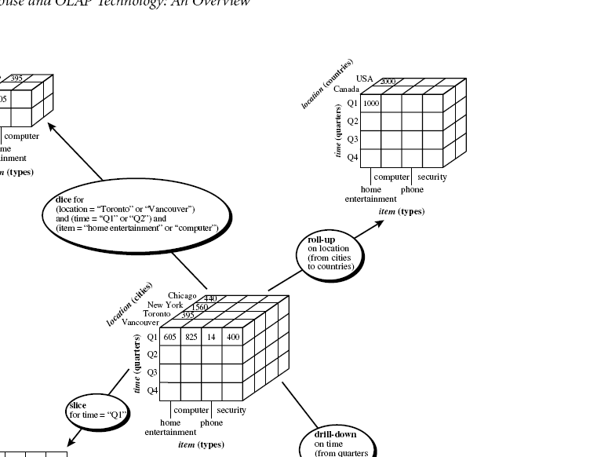
The roll-up operation performs aggregation on a data cube, either by climbing up a concept hierarchy for a dimension or by dimension reduction.
Data Mining: Concepts and Techniques

Slide 40
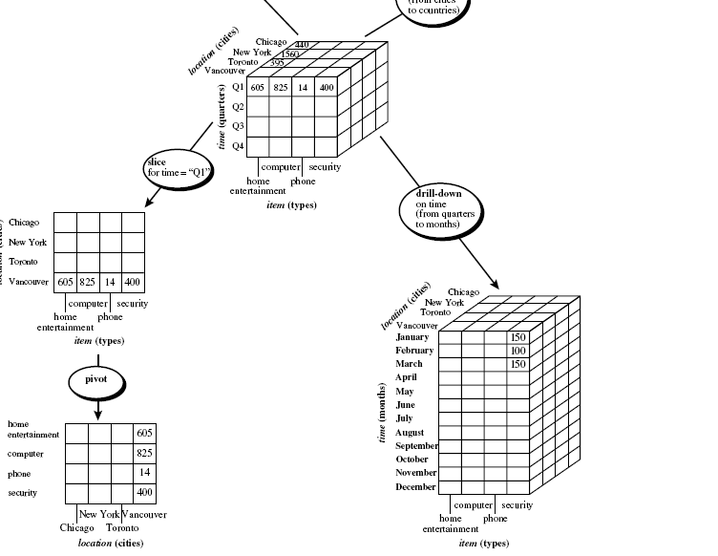
Drill-down is the reverse of roll-up. It navigates from less detailed data to more detailed data. Drill-down can be realized by either stepping down a concept hierarchy
for a dimension or introducing additional dimensions.
Data Mining: Concepts and Techniques

Slide 41
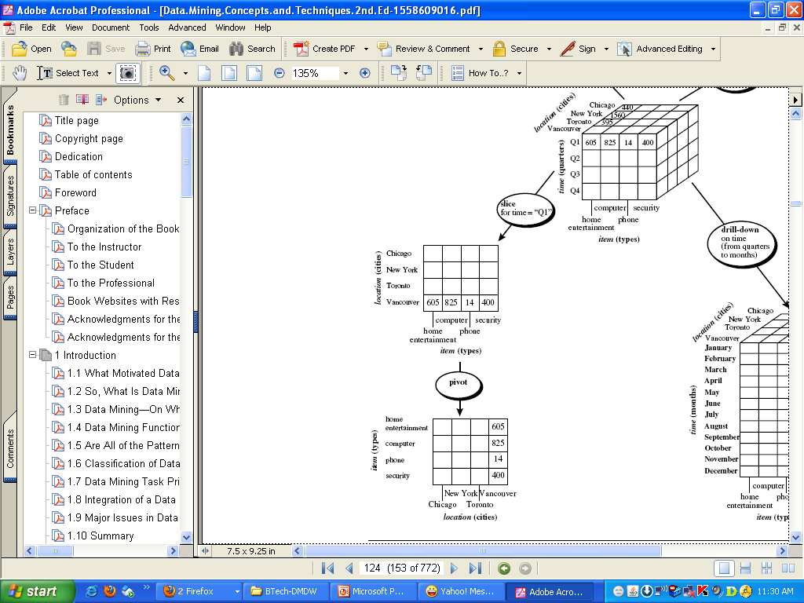
slice operation performs a selection on one dimension of the given cube, resulting in a subcube.
Pivot (also called rotate) is a visualization operation that rotates the data axes in view in order to provide an alternative presentation of the data.
Data Mining: Concepts and Techniques

Slide 42
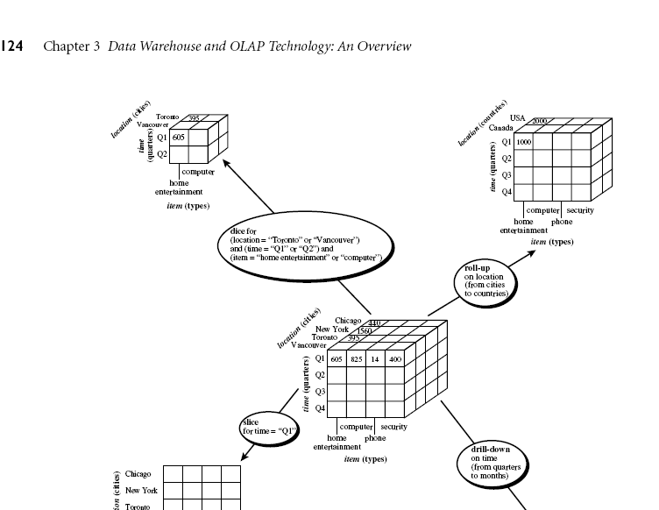
dice operation defines a subcube by performing a selection on two or more dimensions
Data Mining: Concepts and Techniques

Slide 43

Typical OLAP Operations
Data Mining: Concepts and Techniques

Slide 44
Data Warehousing and OLAP Technology: An Overview
What is a data warehouse?
A multi-dimensional data model
Data warehouse architecture
Data warehouse implementation
From data warehousing to data mining
Data Mining: Concepts and Techniques

Slide 45
Design of Data Warehouse: A Business Analysis Framework
Four views regarding the design of a data warehouse
Top-down view
  allows selection of the relevant information necessary for the data warehouse
Data source view
  exposes the information being captured, stored, and managed by operational systems
Data warehouse view
  consists of fact tables and dimension tables
Business query view
  sees the perspectives of data in the warehouse from the view of end-user
Data Mining: Concepts and Techniques

Slide 46
Approaches of DW Design Process
Top-down, bottom-up approaches or a combination of both
  Top-down: Starts with overall design and planning (mature)
  Bottom-up: Starts with experiments and prototypes (rapid)
From software engineering point of view
  Waterfall: structured and systematic analysis at each step before proceeding to the next
  Spiral: rapid generation of increasingly functional systems, short turn around time, quick turn around
Data Mining: Concepts and Techniques

Slide 47
Steps for DW design process
Typical data warehouse design process
  Choose a business process to model, e.g., orders, invoices, etc.
  Choose the grain (atomic level of data) of the business process
  Choose the dimensions that will apply to each fact table record
  Choose the measure that will populate each fact table record
Data Mining: Concepts and Techniques

Slide 48
Data Warehouse: A Multi-Tiered Architecture
Monitor
&
Integrator
OLAP Server
Other
sources
Metadata
Analysis
Query
Reports
Data mining
Operational
DBs
Extract
Transform
Load
Refresh
Data
Warehouse
Serve
Data Marts
Data Sources
Data Storage
OLAP Engine
Front-End Tools
Data Mining: Concepts and Techniques

Slide 49
Three Data Warehouse Models
Enterprise warehouse
  collects all of the information about subjects spanning the entire organization
Data Mart
  a subset of corporate-wide data that is of value to a specific groups of users. Its scope is confined to specific, selected groups, such as marketing data mart
    Independent vs. dependent (directly from warehouse) data mart
Virtual warehouse
  A set of views over operational databases
  Only some of the possible summary views may be materialized
Data Mining: Concepts and Techniques

Slide 50
Data Warehouse Development: A Recommended Approach
Multi-Tier Data Warehouse
Distributed Data Marts
Enterprise Data Warehouse
Data Mart
Data Mart
Model refinement
Model refinement
Define a high-level corporate data model
Data Mining: Concepts and Techniques

Slide 51
Data Warehouse Back-End Tools and Utilities
Data extraction
  get data from multiple, heterogeneous, and external sources
Data cleaning
  detect errors in the data and rectify them when possible
Data transformation
  convert data from legacy or host format to warehouse format
Load
  sort, summarize, consolidate, compute views, check integrity, and build indicies and partitions
Refresh
  propagate the updates from the data sources to the warehouse
Data Mining: Concepts and Techniques

Slide 52
Metadata Repository
Meta data is the data defining warehouse objects. It stores:
Description of the structure of the DW
Operational meta-data
  data lineage
  data currency
  monitoring info
The mapping from operational environment to the DW
The algorithms used for summarization
Data related to system performance
Business metadata
Data Mining: Concepts and Techniques

Slide 53
Metadata Repository
Description of the structure of the DW
  schema, view, dimensions, hierarchies, derived data defn, data mart locations and contents
Operational meta-data
  data lineage (history of migrated data and transformation path), data currency (active, archived, or purged), monitoring info. (warehouse usage statistics, error reports, audit trails)
The mapping from operational environment to the DW
The algorithms used for summarization
Data related to system performance
  warehouse schema, view and derived data definitions
Business metadata
  business terms and definitions, ownership of data, charging policies
Data Mining: Concepts and Techniques

Slide 54
OLAP Server Architectures
Relational OLAP (ROLAP)
  Use relational or extended-relational DBMS to store and manage warehouse data and OLAP middle ware
  Include optimization of DBMS backend, implementation of aggregation navigation logic, and additional tools and services
  Greater scalability
Multidimensional OLAP (MOLAP)
  Sparse array-based multidimensional storage engine
  Fast indexing to pre-computed summarized data
Hybrid OLAP (HOLAP) (e.g., Microsoft SQLServer)
  Flexibility, e.g., low level: relational, high-level: array
Specialized SQL servers (e.g., Redbricks)
  Specialized support for SQL queries over star/snowflake schemas
Data Mining: Concepts and Techniques

Slide 55
Data Warehousing and OLAP Technology: An Overview
What is a data warehouse?
A multi-dimensional data model
Data warehouse architecture
Data warehouse implementation
From data warehousing to data mining
Data Mining: Concepts and Techniques

Slide 56
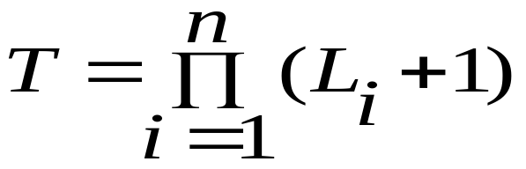

Efficient Data Cube Computation
Data cube can be viewed as a lattice of cuboids
  The bottom-most cuboid is the base cuboid
  The top-most cuboid (apex) contains only one cell
  How many cuboids in an n-dimensional cube with L levels?
Date
TV
1Qtr
2Qtr
3Qtr
4Qtr
sum
Product
PC
U.S.A
VCR
sum
Canada
Country
Mexico
sum
Data Mining: Concepts and Techniques
All, All, All

Slide 57
Efficient Data Cube Computation Contd..)
Materialization of data cube
  Materialize every (cuboid) (full materialization),
  none (no materialization), or
  some (partial materialization):Selection of which cuboids to materialize(Based on size, sharing, access frequency, etc)
Date
TV
1Qtr
2Qtr
3Qtr
4Qtr
sum
Product
PC
U.S.A
VCR
sum
Canada
Country
Mexico
sum
Data Mining: Concepts and Techniques
All, All, All

Slide 58
Cube Operation
Cube definition and computation in DMQL
    define cube sales[item, city, year]: sum(sales_in_dollars)
    compute cube sales
Transform it into a SQL-like language (with a new operator cube by, introduced by Gray et al.’96)
    SELECT item, city, year, SUM (amount)
    FROM SALES
    CUBE BY item, city, year
()
(city)
(item)
(year)
(city, item)
(city, year)
(item, year)
Data Mining: Concepts and Techniques
(city, item, year)

Slide 59



Indexing OLAP Data: Bitmap Index
Index on a particular column
Each value in the column has a bit vector: bit-op is fast
The length of the bit vector: # of records in the base table
The i-th bit is set if the i-th row of the base table has the value for the indexed column
not suitable for high cardinality domains
Base table
Index on Region
Index on Type
Data Mining: Concepts and Techniques

Slide 60
Indexing OLAP Data: Join Indices
Join index: JI(R-id, S-id) where R (R-id, …)  S (S-id, …)
Traditional indices map the values to a list of record ids
  It materializes relational join in JI file and speeds up relational join
In data warehouses, join index relates the values of the dimensions of a star schema to rows in the fact table.
  E.g. fact table: Sales and two dimensions city and product
    A join index on city maintains for each distinct city a list of R-IDs of the tuples recording the Sales in the city
  Join indices can span multiple dimensions
Data Mining: Concepts and Techniques

Slide 61

Indexing OLAP Data: Join Indices
Data Mining: Concepts and Techniques

Slide 62
Efficient Processing OLAP Queries
Determine which operations should be performed on the available cuboids
  Transform drill, roll, etc. into corresponding SQL and/or OLAP operations, e.g., dice = selection + projection
Determine which materialized cuboid(s) should be selected for OLAP op. -- Which should be selected to process the query?
  Let the query to be processed be on {brand, province_or_state} with the condition “year = 2004”, and there are 4 materialized cuboids available:
    1) {year, item_name, city} 2) {year, brand, country}
    3) {year, brand, province_or_state} 4) {item_name, province_or_state} where year = 2004
Explore indexing structures and compressed vs. dense array structs in MOLAP
Data Mining: Concepts and Techniques

Slide 63
Data Warehousing and OLAP Technology: An Overview
What is a data warehouse?
A multi-dimensional data model
Data warehouse architecture
Data warehouse implementation
From data warehousing to data mining
Data Mining: Concepts and Techniques

Slide 64
Data Warehouse Usage
Three kinds of data warehouse applications
  Information processing
    supports querying, basic statistical analysis, and reporting using crosstabs, tables, charts and graphs
  Analytical processing
    multidimensional analysis of data warehouse data
    supports basic OLAP operations, slice-dice, drilling, pivoting
  Data mining
    knowledge discovery from hidden patterns
    supports associations, constructing analytical models, performing classification and prediction, and presenting the mining results using visualization tools
Data Mining: Concepts and Techniques

Slide 65
From On-Line Analytical Processing (OLAP) to On Line Analytical Mining (OLAM)
(OLAM=OLAP+DM & mining kn in multi-D DBs.)
Why online analytical mining?
High quality of data in DW
  DW contains integrated, consistent, cleaned data
Available information processing structure surrounding DW
  ODBC, OLEDB, Web accessing, service facilities, reporting and OLAP tools
OLAP-based exploratory data analysis
  Mining with drilling, dicing, pivoting, etc.
On-line selection of data mining functions
  Integration and swapping of multiple mining functions, algorithms, and tasks
Data Mining: Concepts and Techniques

Slide 66
An OLAM System Architecture
Mining query
Mining result
Layer4
User Interface
User GUI API
OLAM
Engine
OLAP
Engine
Layer3
OLAP/OLAM
Data Cube API
Layer2
MDDB
MDDB
Meta Data
Filtering&Integration
Database API
Filtering
Layer1
Data Repository
Data cleaning
Data
Warehouse
Databases
Data integration
Data Mining: Concepts and Techniques

Slide 67
Data Warehousing and OLAP Technology: An Overview
What is a data warehouse?
A multi-dimensional data model
Data warehouse architecture
Data warehouse implementation
From data warehousing to data mining
Summary
Data Mining: Concepts and Techniques

Slide 68
Summary: Data Warehouse and OLAP Technology
Why data warehousing?
A multi-dimensional model of a data warehouse
  Star schema, snowflake schema, fact constellations
  A data cube consists of dimensions & measures
OLAP operations: drilling, rolling, slicing, dicing and pivoting
Data warehouse architecture
OLAP servers: ROLAP, MOLAP, HOLAP
Efficient computation of data cubes
  Partial vs. full vs. no materialization
  Indexing OALP data: Bitmap index and join index
  OLAP query processing
From OLAP to OLAM (on-line analytical mining)
Data Mining: Concepts and Techniques

Slide 69
Exercises
1. Briefly compare the following concepts with example to explain:
  (a) Snowflake schema, fact constellation, starnet query model
  (b) Data cleaning, data transformation, refresh
  (c) Discovery-driven cube, multifeature cube, virtual warehouse
2. Suppose that a data warehouse consists of the three dimensions time, doctor, and patient, and the two measures count and charge, where charge is the fee that a doctor charges a patient for a visit.
  Enumerate three classes of schemas that are popularly used for modeling data warehouses.
  Draw a schema diagram for the above data warehouse using one of the schema classes
  Starting with the base cuboid [day, doctor,patient], what specific OLAP operations should be performed in order to list the total fee collected by each doctor in 2010?
  To obtain the same list, write an SQL query assuming the data are stored in a relational database with the schema fee (day, month, year, doctor, hospital, patient, count, charge).
Data Mining: Concepts and Techniques

Slide 70
Exercises
3. Suppose that a data warehouse for Big University consists of the four dimensions student, course, semester, and instructor, and two measures count and avg grade. At the lowest conceptual level (e.g., for a given student, course, semester, and instructor combination), the avg grade measure stores the actual course grade of the student. At higher conceptual levels, avg grade stores the average grade for the given combination.
(a) Draw a snowflake schema diagram for the data warehouse.
(b) Starting with the base cuboid [student, course, semester, instructor], what specific OLAP operations (e.g., roll-up from semester to year) should you perform in order to list the average grade of CS courses for each Big University student.
(c) If each dimension has five levels (including all), such as “student < major < status < university < all”, how many cuboids will this cube contain (including the base and apex cuboids)?
.
Data Mining: Concepts and Techniques

Slide 71
Exercises
4. Suppose that a data warehouse consists of the four dimensions date, spectator, location, and game, and the two measures count and charge, where charge is the fare that a spectator pays when watching a game on a given date. Spectators may be students, adults, or seniors, with each category having its own charge rate.
(a) Draw a star schema diagram for the data warehouse.
(b) Starting with the base cuboid [date, spectator, location, game], what specific OLAP operations should you perform in order to list the total charge paid by student spectators at GM Place in 2010?
(c) Bitmap indexing is useful in data warehousing. Taking this cube as an example, briefly discuss advantages and problems of using a bitmap index structure.
Data Mining: Concepts and Techniques

